Slide 1
10
Classes: A Deeper Look, Part 2

Slide 2
But what, to serve our private ends, Forbids the cheating of our friends?
  Charles Churchill
Instead of this absurd division into sexes they ought to class people as static and dynamic.
  Evelyn Waugh
Have no friends not equal to yourself.
  Confucius

Slide 3
OBJECTIVES
In this chapter you’ll learn:
To specify const (constant) objects and const member functions.
To create objects composed of other objects.
To use friend functions and friend classes.
To use the this pointer.
To create and destroy objects dynamically with operators new and delete, respectively.
To use static data members and member functions.
The concept of a container class.
The notion of iterator classes that walk through the elements of container classes.
To use proxy classes to hide implementation details from a class's clients.

Slide 4
10.1 Introduction
10.2 const (Constant) Objects and const Member Functions
10.3 Composition: Objects as Members of Classes
10.4 friend Functions and friend Classes
10.5 Using the this Pointer
10.6 Dynamic Memory Management with Operators new and delete
10.7 static Class Members
10.8 Data Abstraction and Information Hiding
10.8.1 Example: Array Abstract Data Type
10.8.2 Example: String Abstract Data Type
10.8.3 Example: Queue Abstract Data Type
10.9 Container Classes and Iterators
10.10 Proxy Classes
10.11 Wrap-Up

Slide 5
10.1 Introduction
const objects and const member functions
  Prevent modifications of objects
  Enforce the principle of least privilege
Composition
  Classes having objects of other classes as members
Friendship
  Enables class designer to specify that certain non-member functions can access the class’s non-public members

Slide 6
10.1 Introduction (Cont.)
this pointer
Dynamic memory management
  new and delete operators
static class members
Proxy classes
  Hide implementation details of a class from clients
Pointer-base strings
  Used in C legacy code from the last two decades

Slide 7
10.2 const (Constant) Objects and const Member Functions
Principle of least privilege
  One of the most fundamental principles of good software engineering
  Applies to objects, too
const objects
  Keyword const
  Specifies that an object is not modifiable
  Attempts to modify the object will result in compilation errors

Slide 8
Software Engineering Observation 10.1
Declaring an object as const helps enforce the principle of least privilege. Attempts to modify the object are caught at compile time rather than causing execution-time errors. Using const properly is crucial to proper class design, program design and coding.

Slide 9
Performance Tip 10.1
Declaring variables and objects const can improve performance—today’s sophisticated optimizing compilers can perform certain optimizations on constants that cannot be performed on variables.

Slide 10
10.2 const (Constant) Objects and const Member Functions (Cont.)
const member functions
  Only const member function can be called for const objects
  Member functions declared const are not allowed to modify the object
  A function is specified as const both in its prototype and in its definition
  const declarations are not allowed for constructors and destructors

Slide 11
Common Programming Error 10.1
Defining as const a member function that modifies a data member of an object is a compilation error.

Slide 12
Common Programming Error 10.2
Defining as const a member function that calls a non-const member function of the class on the same instance of the class is a compilation error.

Slide 13
Common Programming Error 10.3
Invoking a non-const member function on a const object is a compilation error.

Slide 14
Software Engineering Observation 10.2
A const member function can be overloaded with a non-const version. The compiler chooses which overloaded member function to use based on the object on which the function is invoked. If the object is const, the compiler uses the const version. If the object is not const, the compiler uses the non-const version.

Slide 15
Common Programming Error 10.4
Attempting to declare a constructor or destructor const is a compilation error.

Slide 16
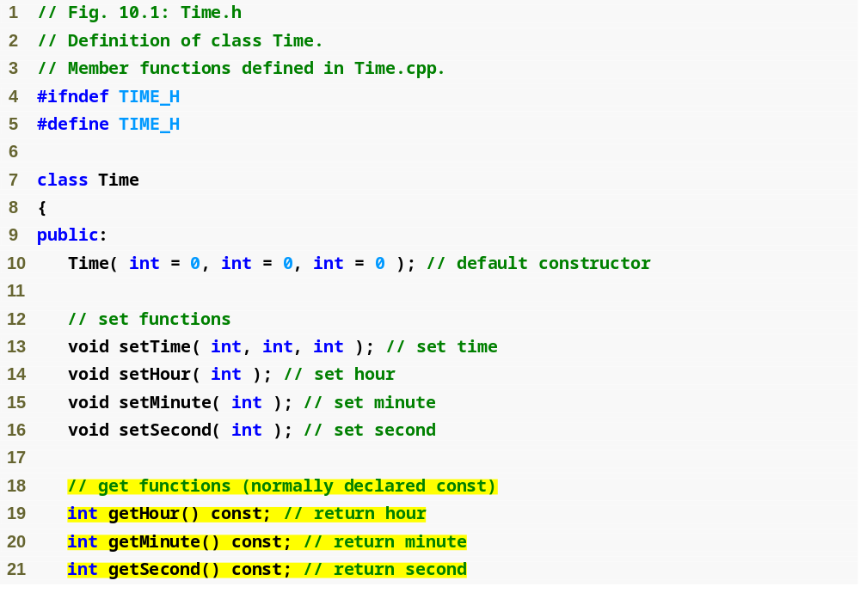
Outline
Time.h
(1 of 2)
const keyword to indicate that member function cannot modify the object

Slide 17
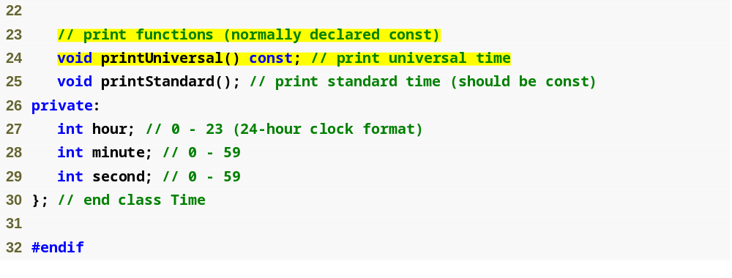
Outline
Time.h
(2 of 2)

Slide 18
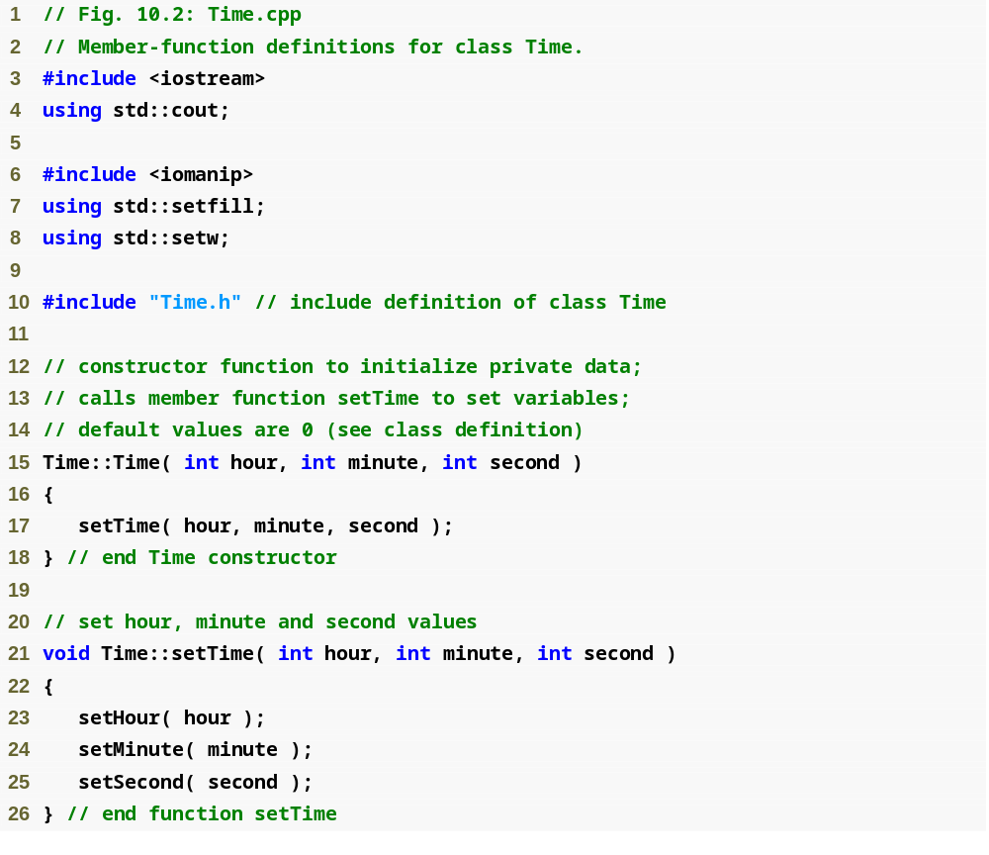
Outline
Time.cpp
(1 of 3)

Slide 19
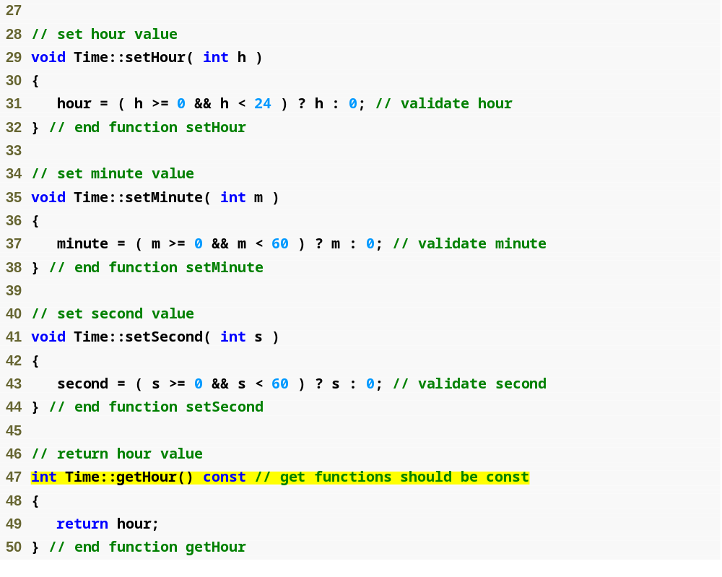
Outline
Time.cpp
(2 of 3)
const keyword in function definition, as well as in function prototype

Slide 20
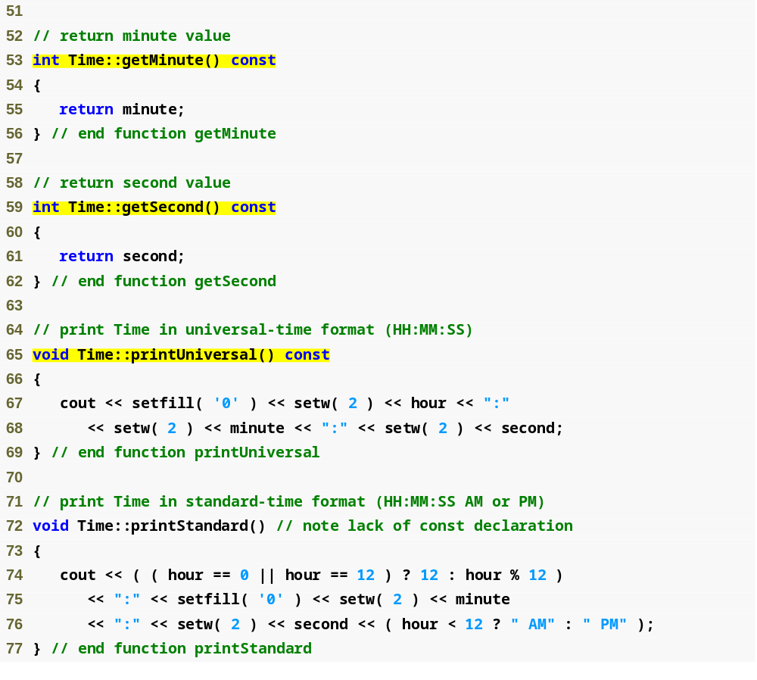
Outline
Time.cpp
(3 of 3)

Slide 21
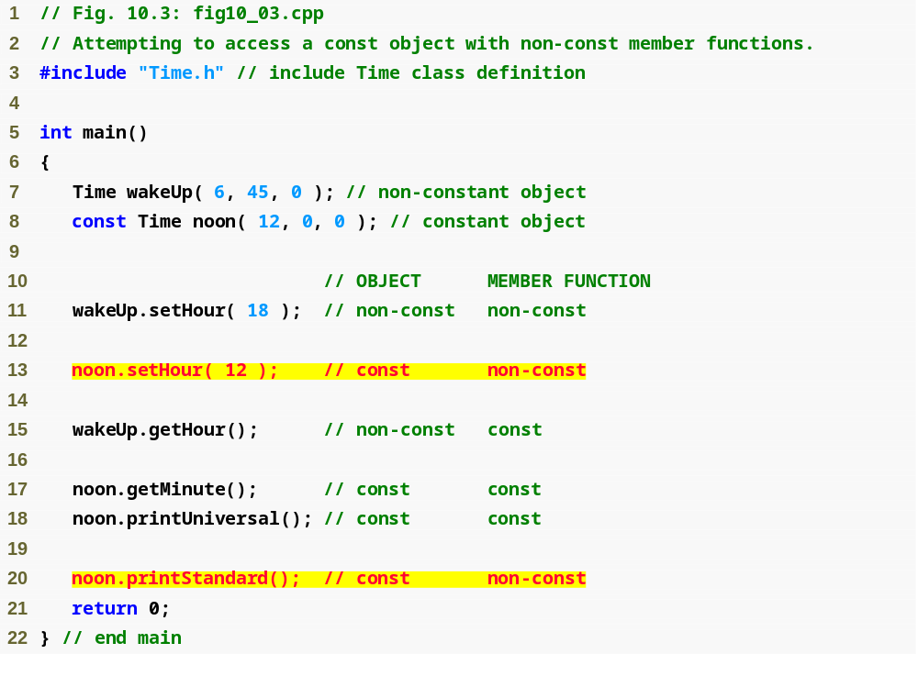
Outline
fig10_03.cpp
(1 of 2)
Cannot invoke non-const member functions on a const object

Slide 22
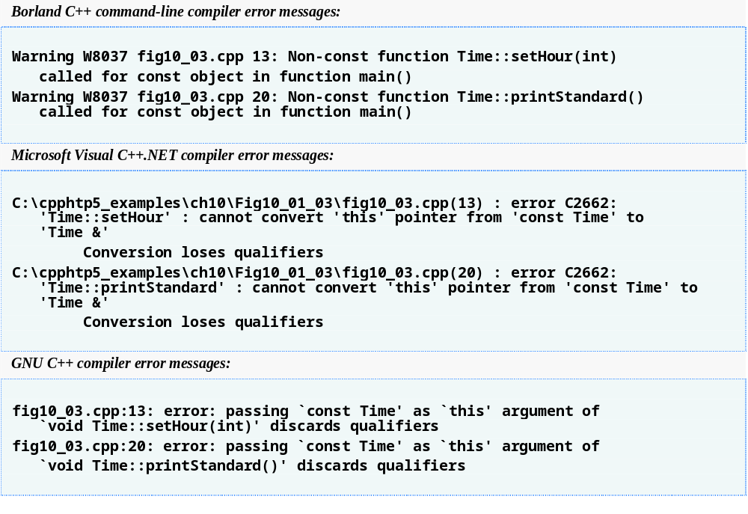
Outline
fig10_03.cpp
(2 of 2)

Slide 23
10.2 const (Constant) Objects and const Member Functions (Cont.)
Member initializer
  Required for initializing
    const data members
    Data members that are references
  Can be used for any data member
Member initializer list
  Appears between a constructor’s parameter list and the left brace that begins the constructor’s body
  Separated from the parameter list with a colon (:)
  Each member initializer consists of the data member name followed by parentheses containing the member’s initial value
  Multiple member initializers are separated by commas
  Executes before the body of the constructor executes

Slide 24
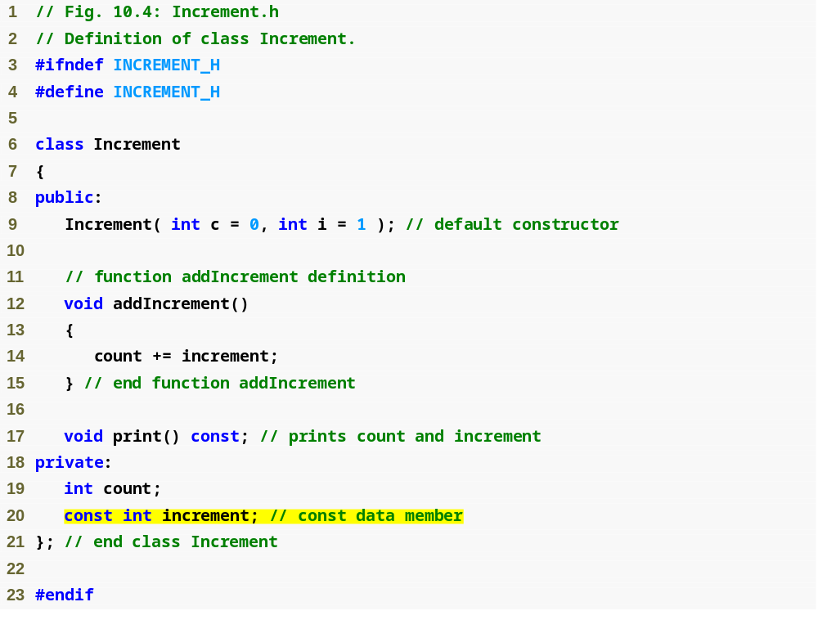
Outline
Increment.h
(1 of 1)
const data member that must be initialized using a member initializer

Slide 25
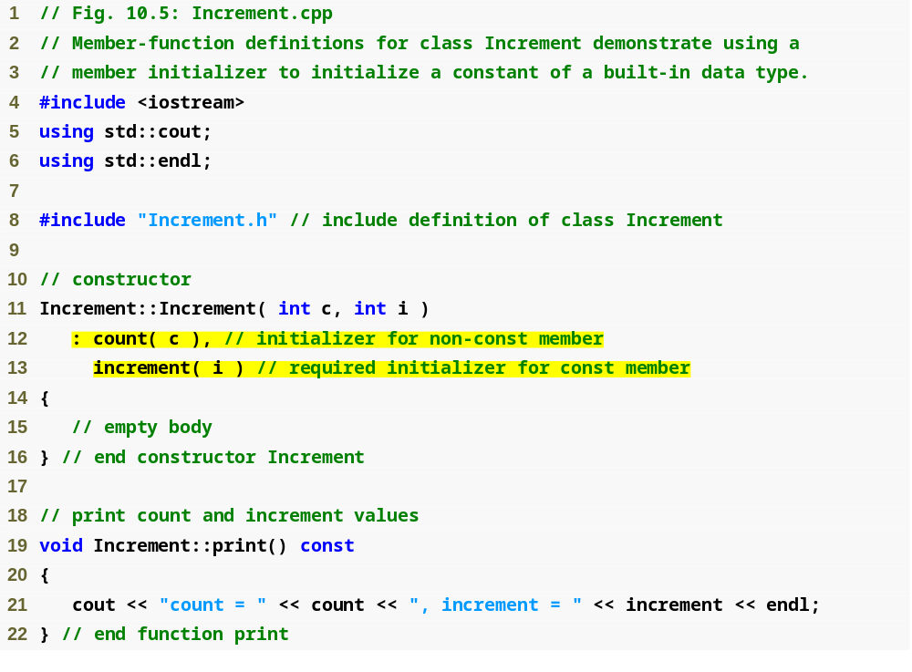
Outline
Increment.cpp
(1 of 1)
Colon (:) marks the start of a member initializer list
Member initializer for non-const member count
Required member initializer for const member increment

Slide 26
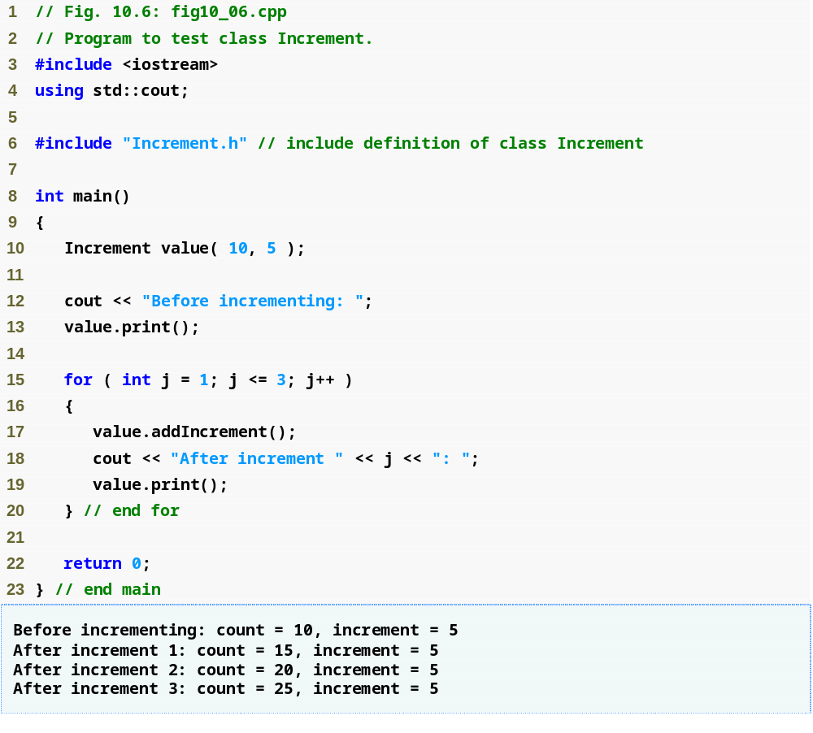
Outline
fig10_06.cpp
(1 of 1)

Slide 27
Software Engineering Observation 10.3
A const object cannot be modified by assignment, so it must be initialized. When a data member of a class is declared const, a member initializer must be used to provide the constructor with the initial value of the data member for an object of the class. The same is true for references.

Slide 28
Common Programming Error 10.5
Not providing a member initializer for a const data member is a compilation error.

Slide 29
Software Engineering Observation 10.4
Constant data members (const objects and const variables) and data members declared as references must be initialized with member initializer syntax; assignments for these types of data in the constructor body are not allowed.

Slide 30
Error-Prevention Tip 10.1
Declare as const all of a class’s member functions that do not modify the object in which they operate. Occasionally this may seem inappropriate, because you will have no intention of creating const objects of that class or accessing objects of that class through const references or pointers to const. Declaring such member functions const does offer a benefit, though. If the member function is inadvertently written to modify the object, the compiler will issue an error message.

Slide 31
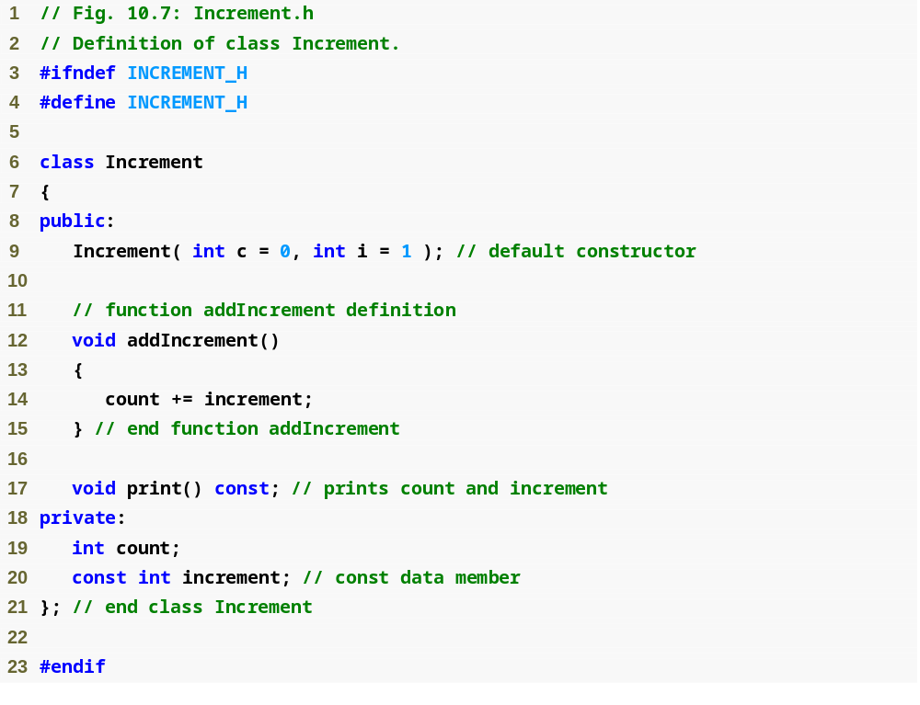
Outline
Increment.h
(1 of 1)
Member function declared const to prevent errors in situations where an Increment object is treated as a const object

Slide 32
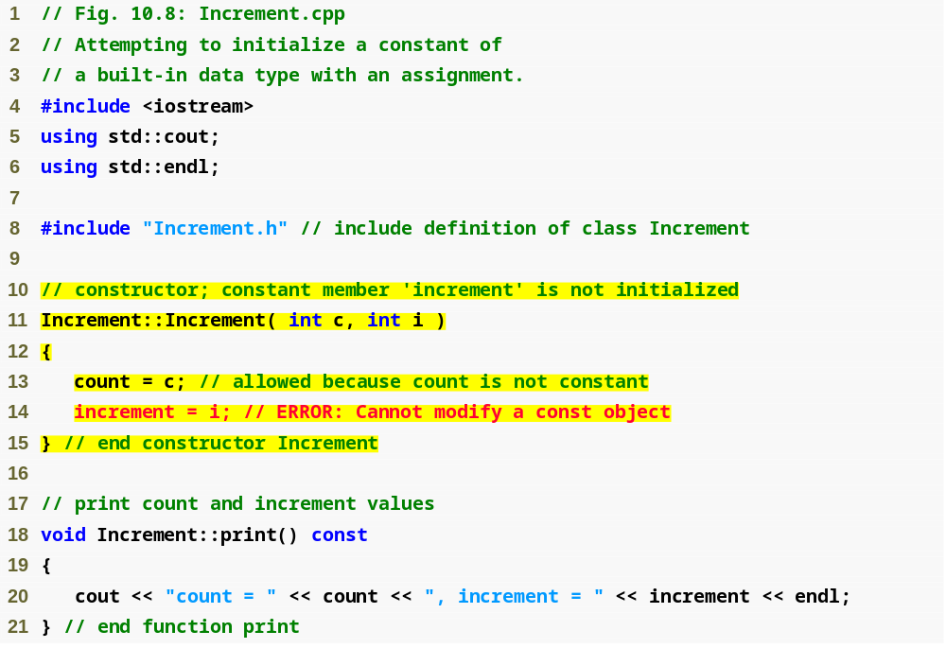
Outline
Increment.cpp
(1 of 1)
It is an error to modify a const data member; data member increment must be initialized with a member initializer

Slide 33
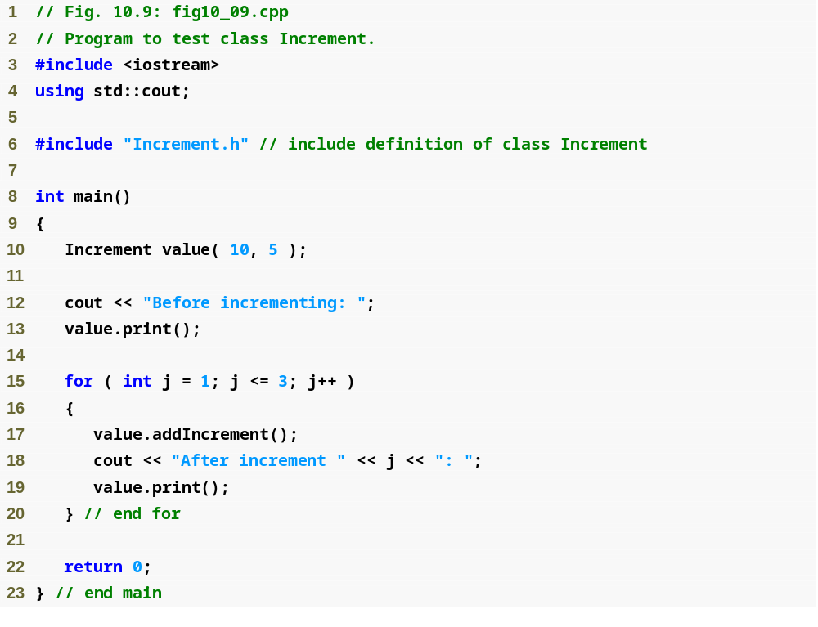
Outline
fig10_09.cpp
(1 of 2)

Slide 34
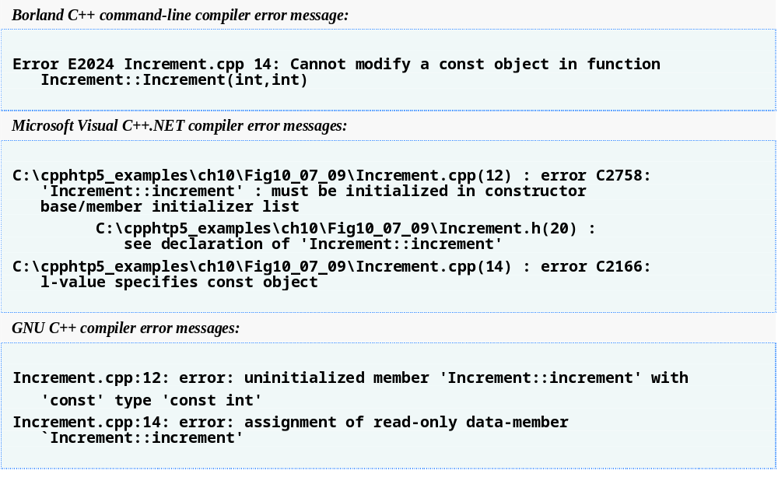
Outline
fig10_09.cpp
(2 of 2)

Slide 35
10.3 Composition: Objects as Members of Classes
Composition
  Sometimes referred to as a has-a relationship
  A class can have objects of other classes as members
  Example
    AlarmClock object with a Time object as a member

Slide 36
10.3 Composition: Objects as Members of Classes (Cont.)
Initializing member objects
  Member initializers pass arguments from the object’s constructor to member-object constructors
  Member objects are constructed in the order in which they are declared in the class definition
    Not in the order they are listed in the constructor’s member initializer list
    Before the enclosing class object (host object) is constructed
  If a member initializer is not provided
    The member object’s default constructor will be called implicitly

Slide 37
Software Engineering Observation 10.5
A common form of software reusability is composition, in which a class has objects of other classes as members.

Slide 38
Software Engineering Observation 10.6
Member objects are constructed in the order in which they are declared in the class definition (not in the order they are listed in the constructor’s member initializer list) and before their enclosing class objects (sometimes called host objects) are constructed.

Slide 39
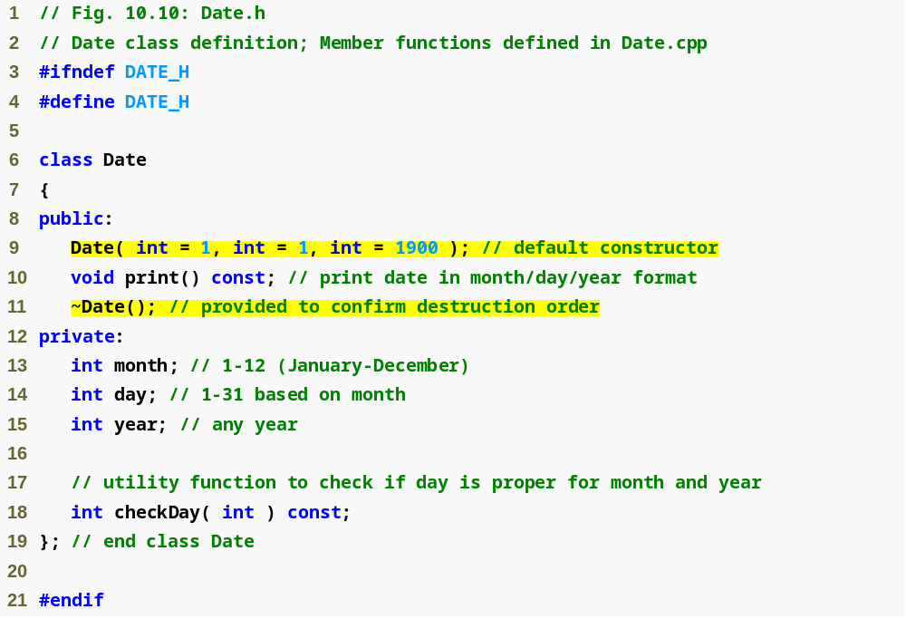
Outline
Date.h
(1 of 1)

Slide 40
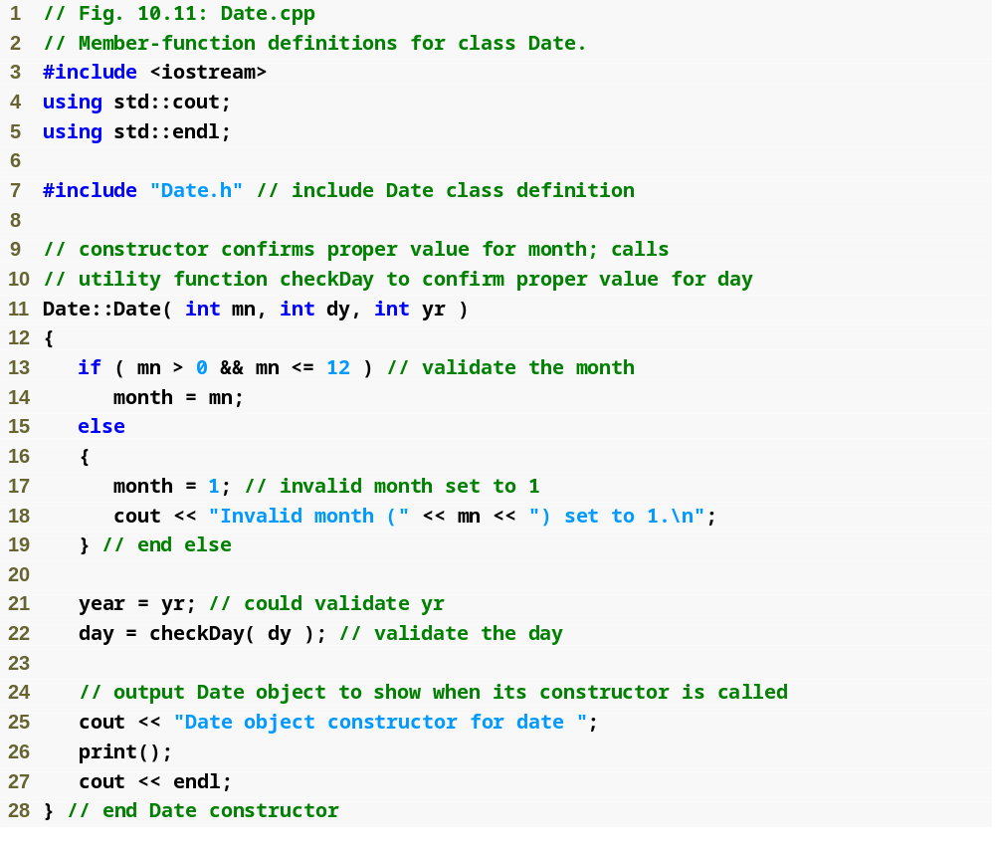
Outline
Date.cpp
(1 of 3)

Slide 41
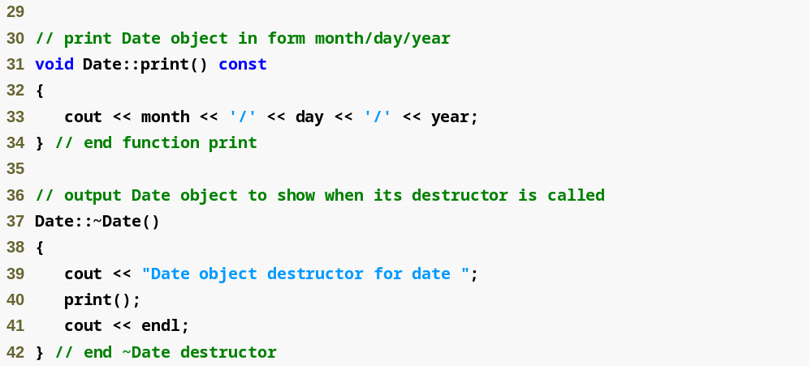
Outline
Date.cpp
(2 of 3)

Slide 42
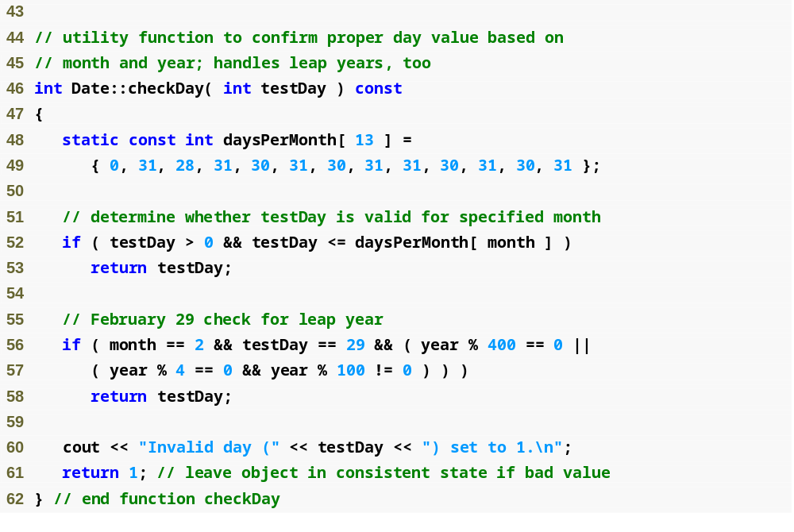
Outline
Date.cpp
(3 of 3)

Slide 43
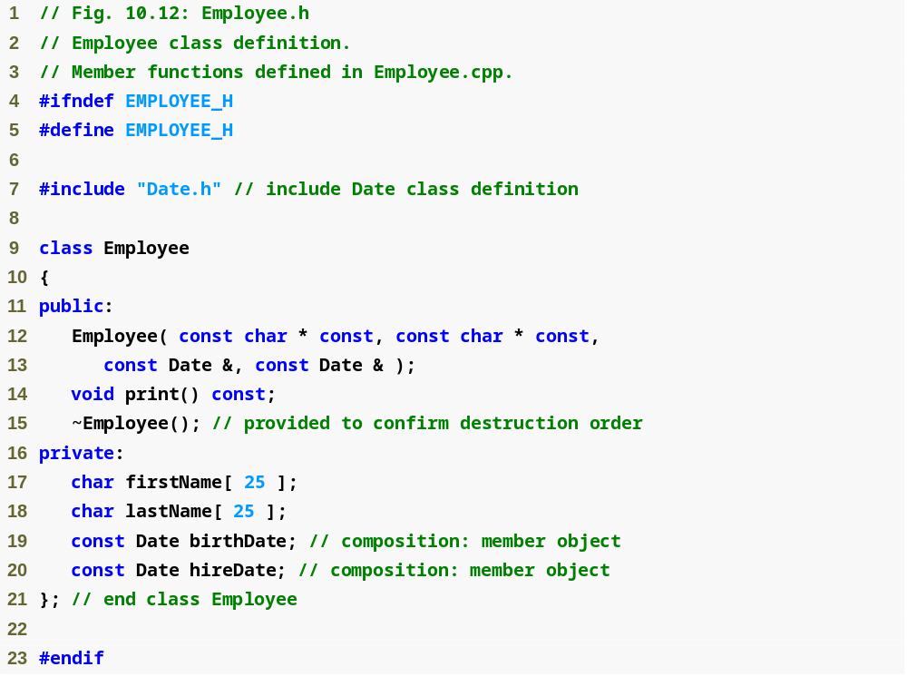
Outline
Employee.h
(1 of 1)
Parameters to be passed via member initializers to the constructor for class Date
const objects of class Date as members

Slide 44
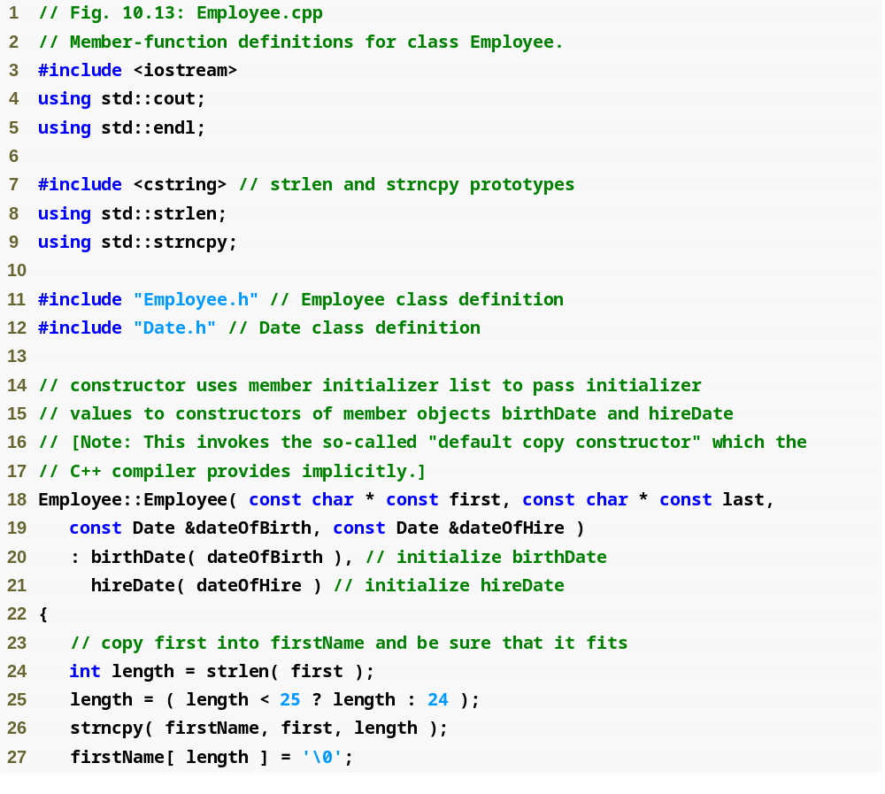
Outline
Employee.cpp
(1 of 2)
Member initializers that pass arguments to Date’s implicit default copy constructor

Slide 45
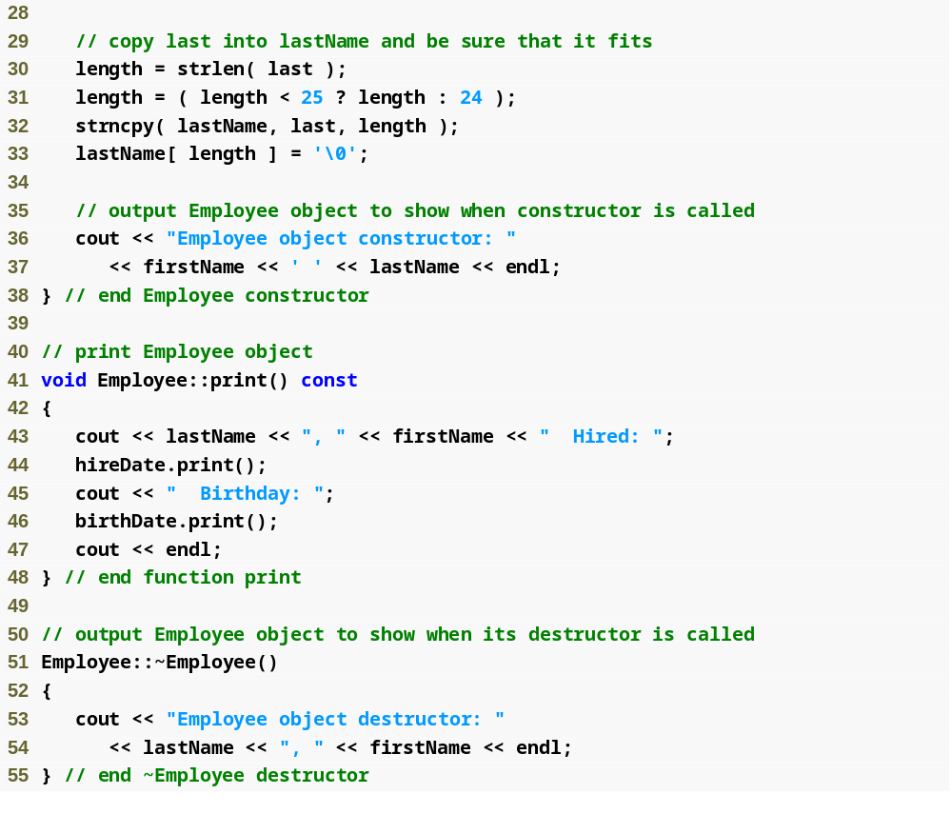
Outline
Employee.cpp
(2 of 2)

Slide 46
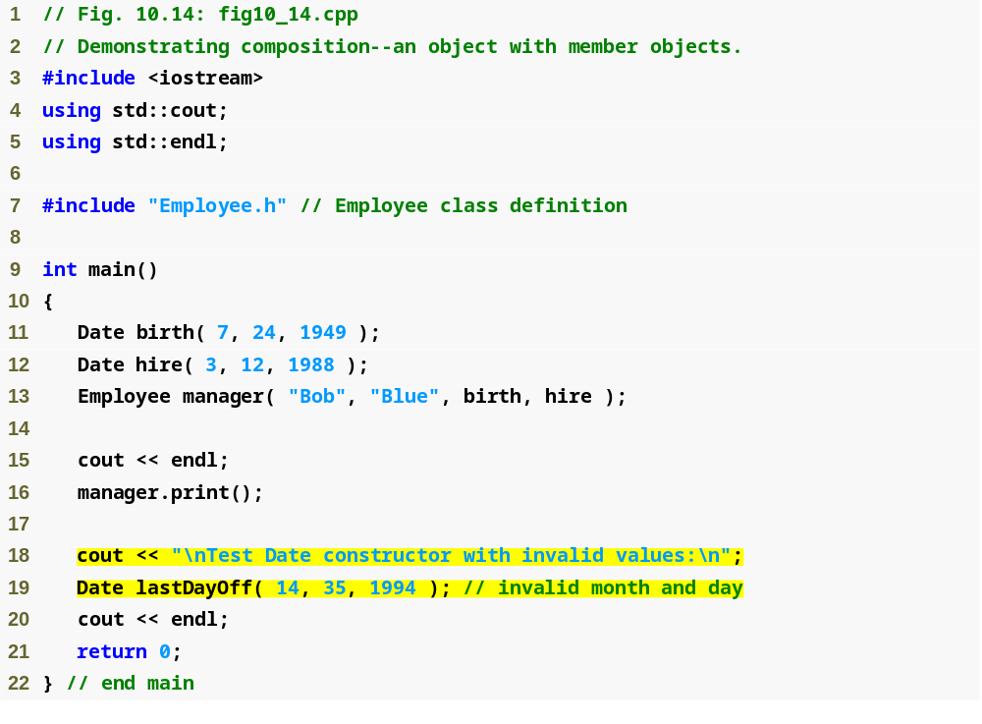
Outline
fig10_14.cpp
(1 of 2)
Passing objects to a host object constructor

Slide 47
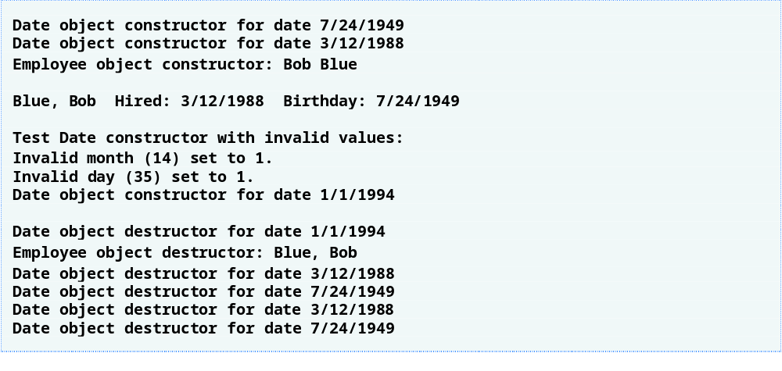
Outline
fig10_14.cpp
(2 of 2)

Slide 48
Common Programming Error 10.6
A compilation error occurs if a member object is not initialized with a member initializer and the member object’s class does not provide a default constructor (i.e., the member object’s class defines one or more constructors, but none is a default constructor).

Slide 49
Performance Tip 10.2
Initialize member objects explicitly through member initializers. This eliminates the overhead of “doubly initializing” member objects—once when the member object’s default constructor is called and again when set functions are called in the constructor body (or later) to initialize the member object.

Slide 50
Software Engineering Observation 10.7
If a class member is an object of another class, making that member object public does not violate the encapsulation and hiding of that member object’s private members. However, it does violate the encapsulation and hiding of the containing class’s implementation, so member objects of class types should still be private, like all other data members.

Slide 51
10.4 friend Functions and friend Classes
friend function of a class
  Defined outside that class’s scope
    Not a member function of that class
  Yet has the right to access the non-public (and public) members of that class
  Standalone functions or entire classes may be declared to be friends of a class
  Can enhance performance
  Often appropriate when a member function cannot be used for certain operations

Slide 52
10.4 friend Functions and friend Classes (Cont.)
To declare a function as a friend of a class:
  Provide the function prototype in the class definition preceded by keyword friend
To declare a class as a friend of a class:
  Place a declaration of the form
  friend class ClassTwo;
  in the definition of class ClassOne
    All member functions of class ClassTwo are friends of class ClassOne

Slide 53
10.4 friend Functions and friend Classes (Cont.)
Friendship is granted, not taken
  For class B to be a friend of class A, class A must explicitly declare that class B is its friend
Friendship relation is neither symmetric nor transitive
  If class A is a friend of class B, and class B is a friend of class C, you cannot infer that class B is a friend of class A, that class C is a friend of class B, or that class A is a friend of class C
It is possible to specify overloaded functions as friends of a class
  Each overloaded function intended to be a friend must be explicitly declared as a friend of the class

Slide 54
Software Engineering Observation 10.8
Even though the prototypes for friend functions appear in the class definition, friends are not member functions.

Slide 55
Software Engineering Observation 10.9
Member access notions of private, protected and public are not relevant to friend declarations, so friend declarations can be placed anywhere in a class definition.

Slide 56
Good Programming Practice 10.1
Place all friendship declarations first inside the class definition’s body and do not precede them with any access specifier.

Slide 57
Software Engineering Observation 10.10
Some people in the OOP community feel that “friendship” corrupts information hiding and weakens the value of the object-oriented design approach. In this text, we identify several examples of the responsible use of friendship.

Slide 58
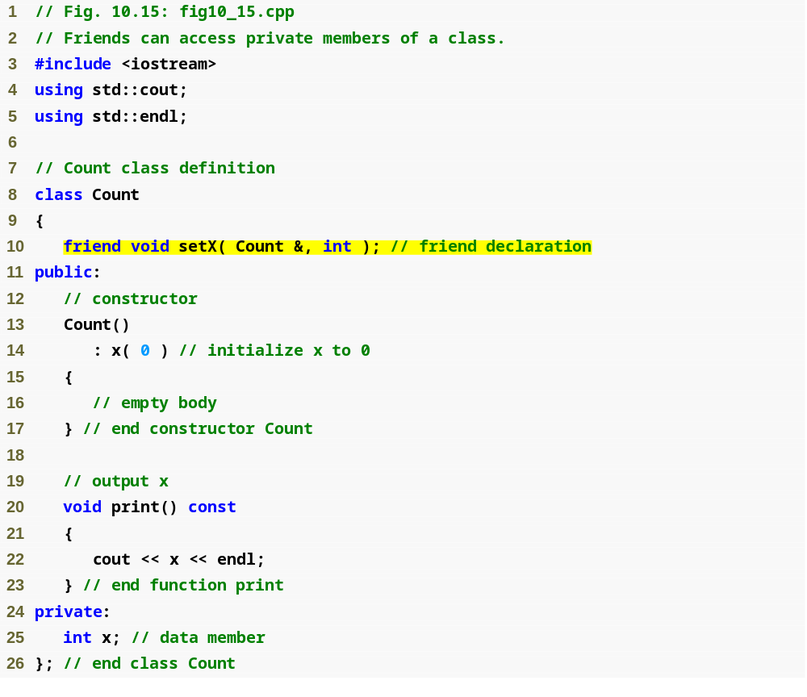
Outline
friend function declaration (can appear anywhere in the class)
fig10_15.cpp
(1 of 2)

Slide 59
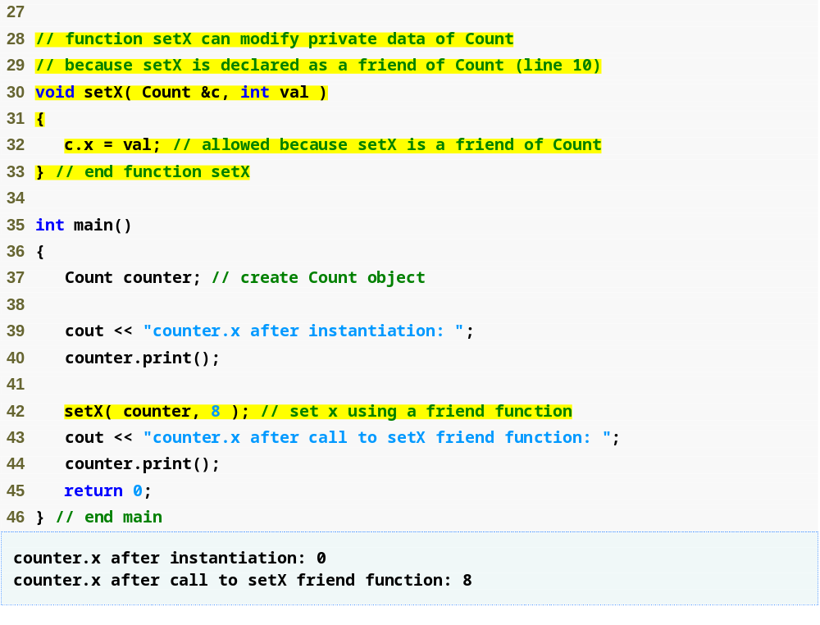
Outline
fig10_15.cpp
(2 of 2)
friend function can modify Count’s private data
Calling a friend function; note that we pass the Count object to the function

Slide 60
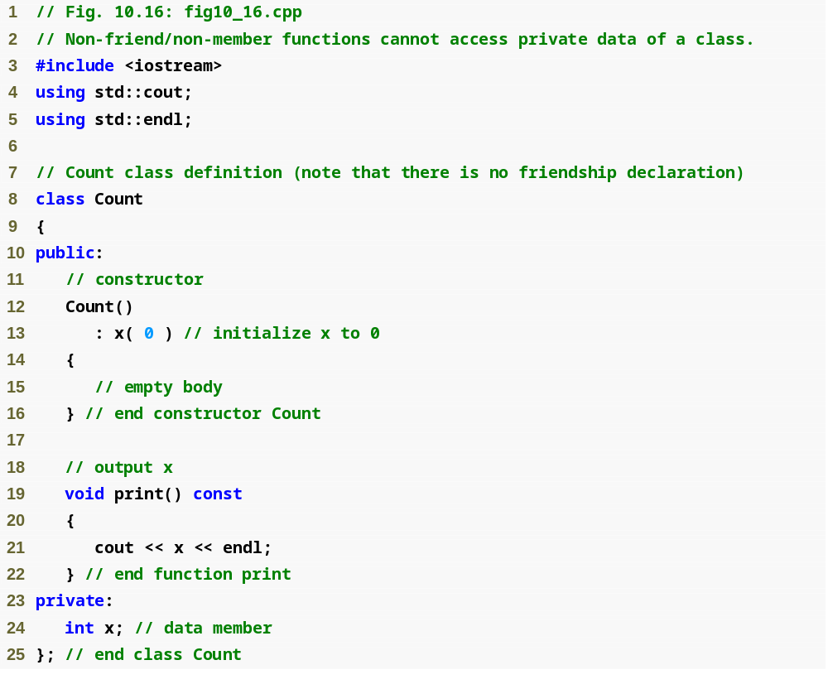
Outline
fig10_16.cpp
(1 of 3)

Slide 61
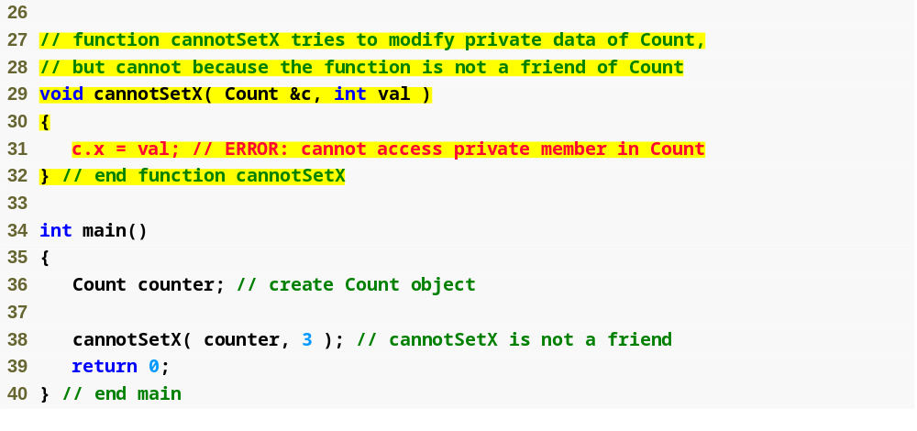
Outline
Non-friend function cannot access the class’s private data
fig10_16.cpp
(2 of 3)

Slide 62
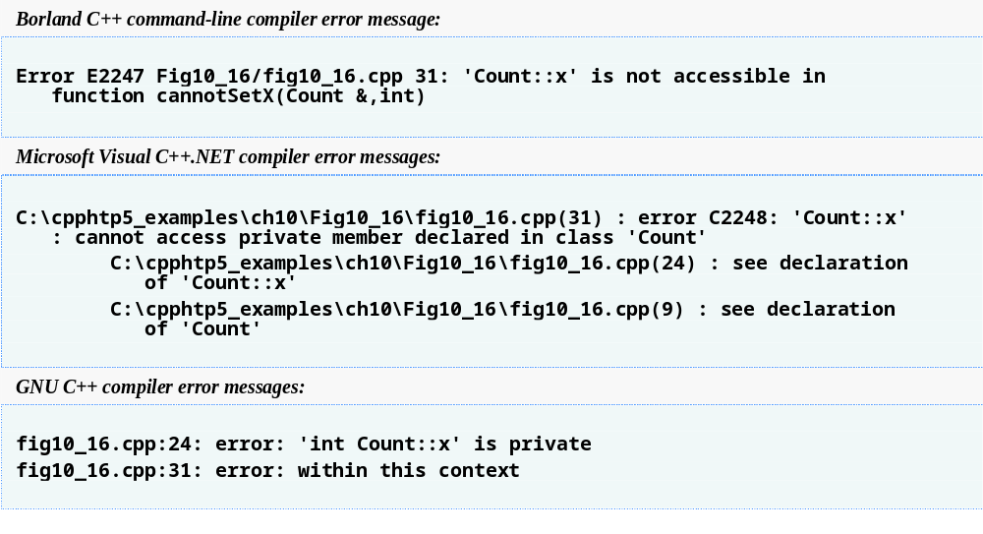
Outline
fig10_16.cpp
(3 of 3)

Slide 63
10.5 Using the this Pointer
Member functions know which object’s data members to manipulate
  Every object has access to its own address through a pointer called this (a C++ keyword)
  An object’s this pointer is not part of the object itself
  The this pointer is passed (by the compiler) as an implicit argument to each of the object’s non-static member functions
Objects use the this pointer implicitly or explicitly
  Implicitly when accessing members directly
  Explicitly when using keyword this
  Type of the this pointer depends on the type of the object and whether the executing member function is declared const

Slide 64
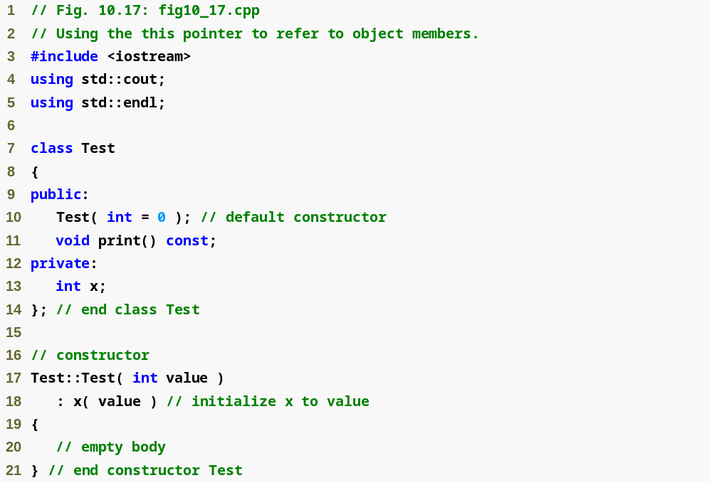
Outline
fig10_17.cpp
(1 of 2)

Slide 65
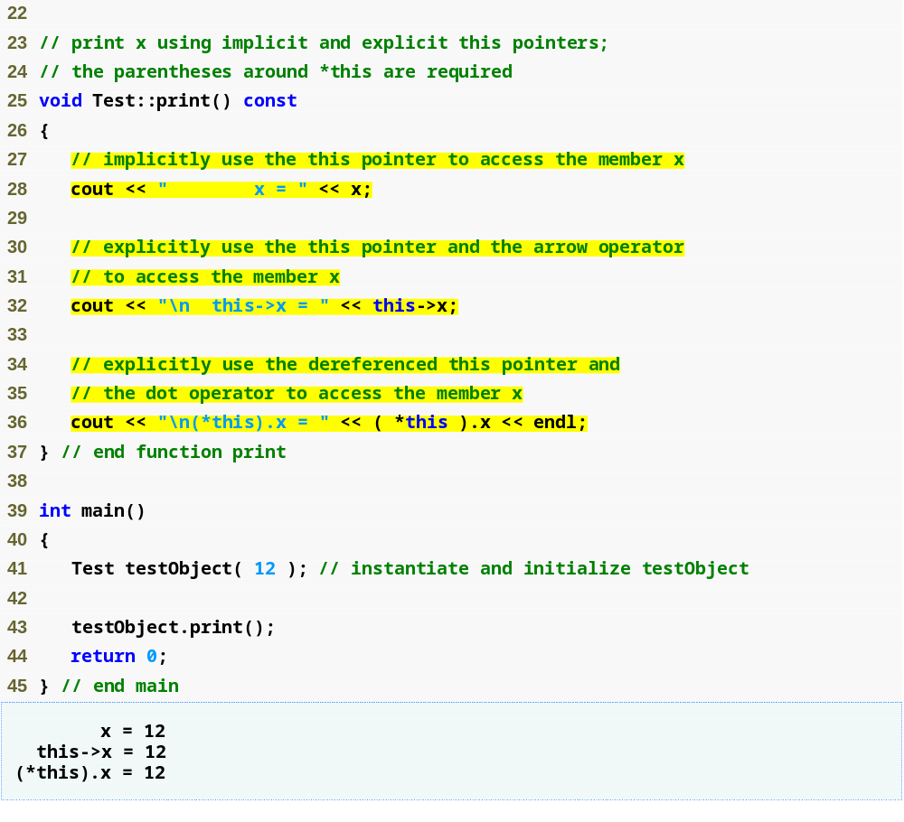
Outline
fig10_17.cpp
(2 of 2)
Implicitly using the this pointer to access member x
Explicitly using the this pointer to access member x
Using the dereferenced this pointer and the dot operator

Slide 66
Common Programming Error 10.7
Attempting to use the member selection operator (.) with a pointer to an object is a compilation error—the dot member selection operator may be used only with an lvalue such as an object’s name, a reference to an object or a dereferenced pointer to an object.

Slide 67
10.5 Using the this Pointer (Cont.)
Cascaded member-function calls
  Multiple functions are invoked in the same statement
  Enabled by member functions returning the dereferenced this pointer
  Example
    t.setMinute( 30 ).setSecond( 22 );
      Calls t.setMinute( 30 );
      Then calls t.setSecond( 22 );

Slide 68
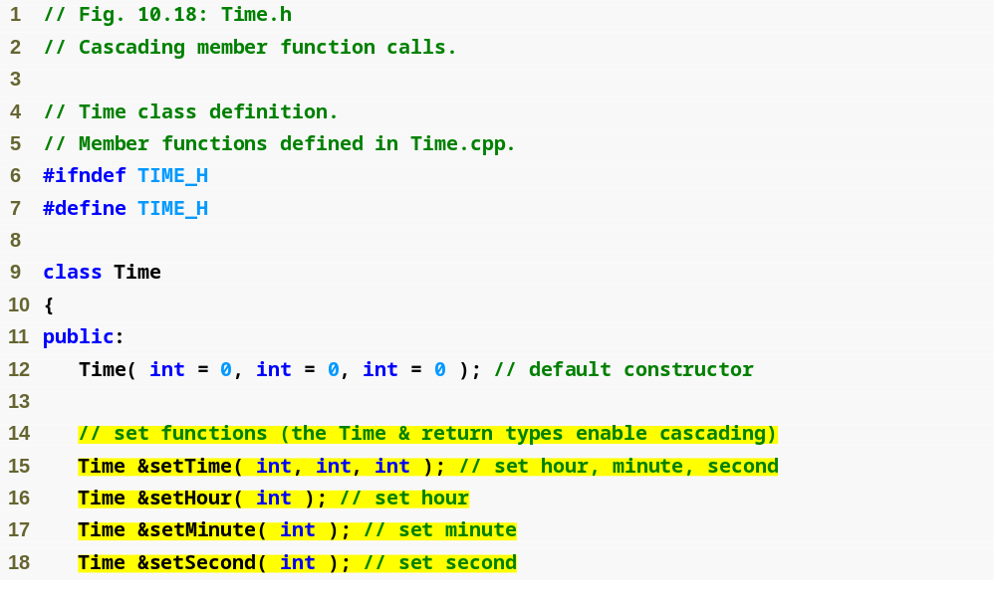
Outline
Time.h
(1 of 2)
set functions return Time & to enable cascading

Slide 69
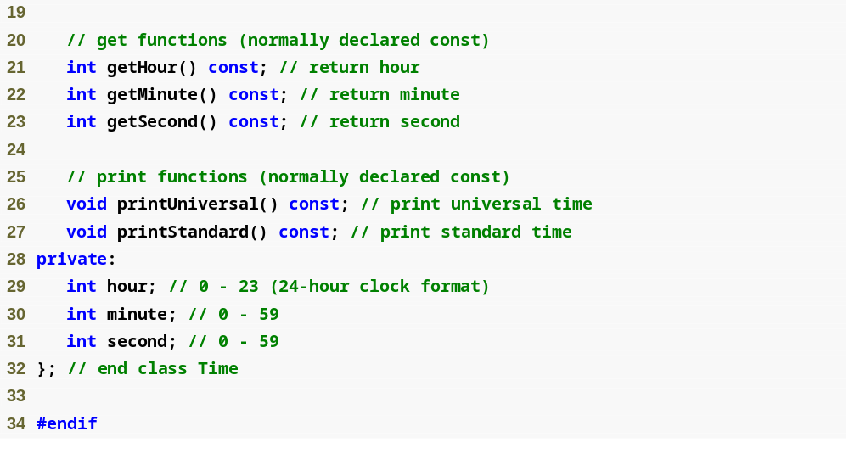
Outline
Time.h
(2 of 2)

Slide 70
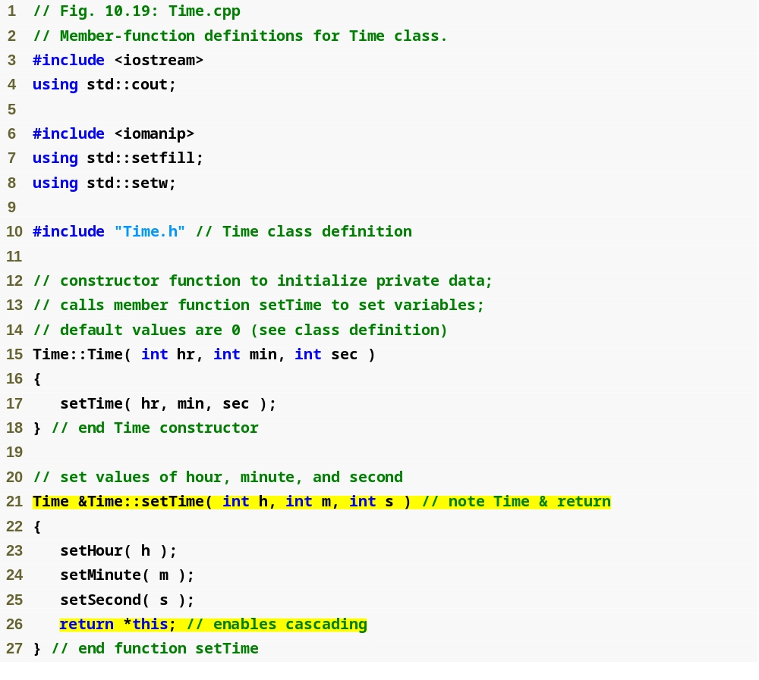
Outline
Time.cpp
(1 of 3)
Returning dereferenced this pointer enables cascading

Slide 71
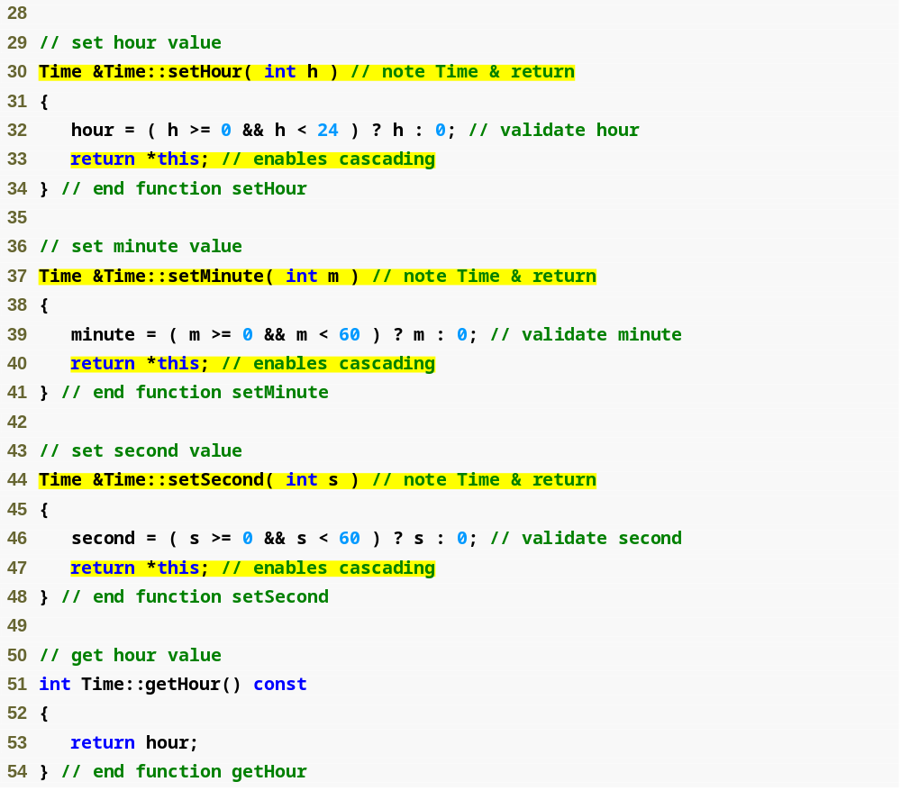
Outline
Time.cpp
(2 of 3)

Slide 72
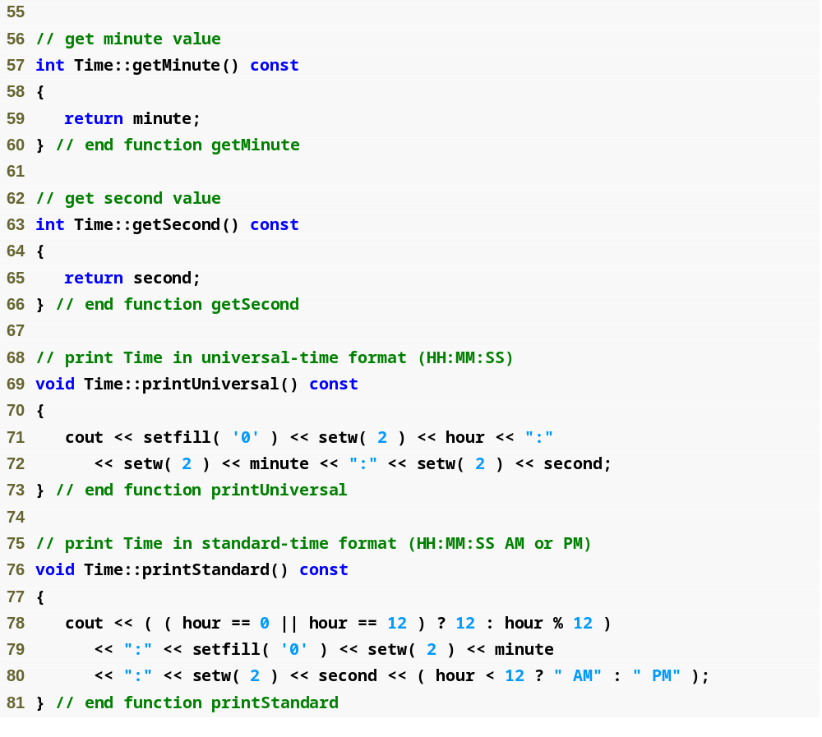
Outline
Time.cpp
(3 of 3)

Slide 73
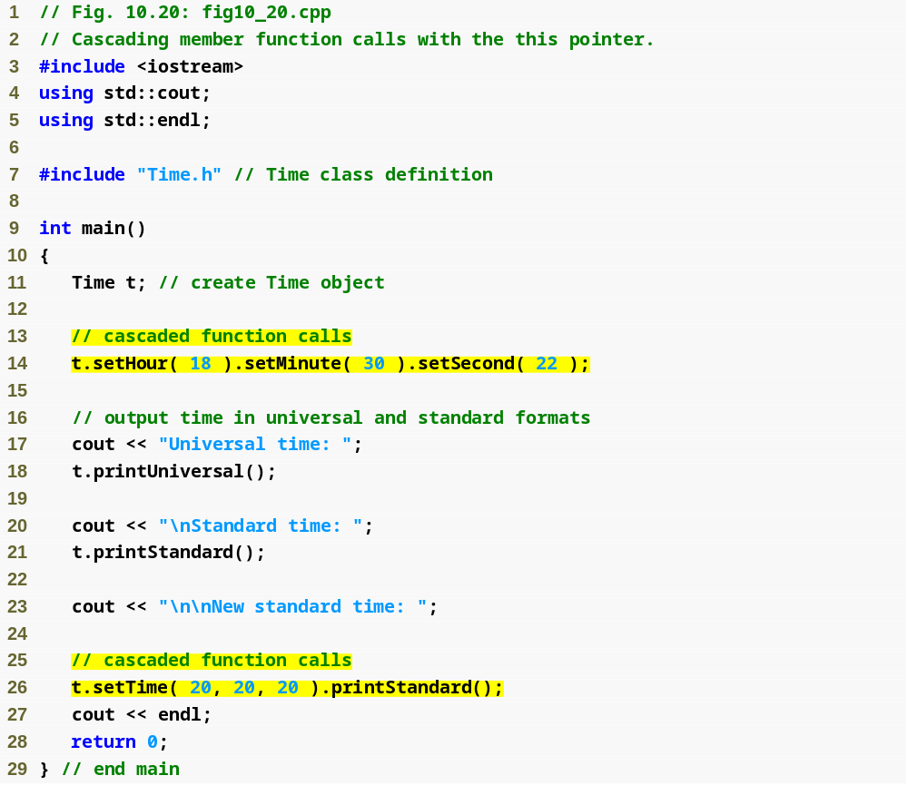
Outline
fig10_20.cpp
(1 of 2)
Cascaded function calls using the reference returned by one function call to invoke the next
Note that these calls must appear in the order shown, because printStandard does not return a reference to t

Slide 74

Outline
fig10_20.cpp
(2 of 2)

Slide 75
10.6 Dynamic Memory Management with Operators new and delete
Dynamic memory management
  Enables programmers to allocate and deallocate memory for any built-in or user-defined type
  Performed by operators new and delete
  For example, dynamically allocating memory for an array instead of using a fixed-size array

Slide 76
10.6 Dynamic Memory Management with Operators new and delete (Cont.)
Operator new
  Allocates (i.e., reserves) storage of the proper size for an object at execution time
  Calls a constructor to initialize the object
  Returns a pointer of the type specified to the right of new
  Can be used to dynamically allocate any fundamental type (such as int or double) or any class type
Free store
  Sometimes called the heap
  Region of memory assigned to each program for storing objects created at execution time

Slide 77
10.6 Dynamic Memory Management with Operators new and delete (Cont.)
Operator delete
  Destroys a dynamically allocated object
  Calls the destructor for the object
  Deallocates (i.e., releases) memory from the free store
  The memory can then be reused by the system to allocate other objects

Slide 78
10.6 Dynamic Memory Management with Operators new and delete (Cont.)
Initializing an object allocated by new
  Initializer for a newly created fundamental-type variable
    Example
      double *ptr = new double( 3.14159 );
  Specify a comma-separated list of arguments to the constructor of an object
    Example
      Time *timePtr = new Time( 12, 45, 0 );

Slide 79
Performance Tip 10.1
On failure, the new operator returns a 0 pointer in versions of C++ prior to the ISO/IEC standard. We use the standard version of operator new throughout this book.

Slide 80
Common Programming Error 10.8
Not releasing dynamically allocated memory when it is no longer needed can cause the system to run out of memory prematurely. This is sometimes called a “memory leak.”

Slide 81
10.6 Dynamic Memory Management with Operators new and delete (Cont.)
new operator can be used to allocate arrays dynamically
  Dynamically allocate a 10-element integer array:
  int *gradesArray = new int[ 10 ];
  Size of a dynamically allocated array
    Specified using any integral expression that can be evaluated at execution time

Slide 82
10.6 Dynamic Memory Management with Operators new and delete (Cont.)
Delete a dynamically allocated array:
  delete [] gradesArray;
  This deallocates the array to which gradesArray points
  If the pointer points to an array of objects
    First calls the destructor for every object in the array
    Then deallocates the memory
  If the statement did not include the square brackets ([]) and gradesArray pointed to an array of objects
    Only the first object in the array would have a destructor call

Slide 83
Common Programming Error 10.9
Using delete instead of delete [] for arrays of objects can lead to runtime logic errors. To ensure that every object in the array receives a destructor call, always delete memory allocated as an array with operator delete []. Similarly, always delete memory allocated as an individual element with operator delete; otherwise, the result of the operation is undefined.

Slide 84
10.7 static Class Members
static data member
  Only one copy of a variable shared by all objects of a class
    “Class-wide” information
    A property of the class shared by all instances, not a property of a specific object of the class
  Declaration begins with keyword static

Slide 85
10.7 static Class Members (Cont.)
static data member (Cont.)
  Example
    Video game with Martians and other space creatures
      Each Martian needs to know the martianCount
      martianCount should be static class-wide data
      Every Martian can access martianCount as if it were a data member of that Martian
      Only one copy of martianCount exists
  May seem like global variables but they have class scope
  Can be declared public, private or protected

Slide 86
10.7 static Class Members (Cont.)
static data member (Cont.)
  Fundamental-type static data members
    Initialized by default to 0
    If you want a different initial value, a static data member can be initialized once (and only once)
  A const static data member of int or enum type
    Can be initialized in its declaration in the class definition
  All other static data members
    Must be defined at file scope (i.e., outside the body of the class definition)
    Can be initialized only in those definitions
  static data members of class types (i.e., static member objects) that have default constructors
    Need not be initialized because their default constructors will be called

Slide 87
10.7 static Class Members (Cont.)
static data member (Cont.)
  Exists even when no objects of the class exist
    To access a public static class member when no objects of the class exist
      Prefix the class name and the binary scope resolution operator (::) to the name of the data member
      Example
        Martian::martianCount
  Also accessible through any object of that class
    Use the object’s name, the dot operator and the name of the member
      Example
        myMartian.martianCount

Slide 88
10.7 static Class Members (Cont.)
static member function
  Is a service of the class, not of a specific object of the class
static applied to an item at file scope
  That item becomes known only in that file
  The static members of the class need to be available from any client code that accesses the file
    So we cannot declare them static in the .cpp file—we declare them static only in the .h file.

Slide 89
Performance Tip 10.3
Use static data members to save storage when a single copy of the data for all objects of a class will suffice.

Slide 90
Software Engineering Observation 10.11
A class’s static data members and static member functions exist and can be used even if no objects of that class have been instantiated.

Slide 91
Common Programming Error 10.10
It is a compilation error to include keyword static in the definition of a static data members at file scope.

Slide 92
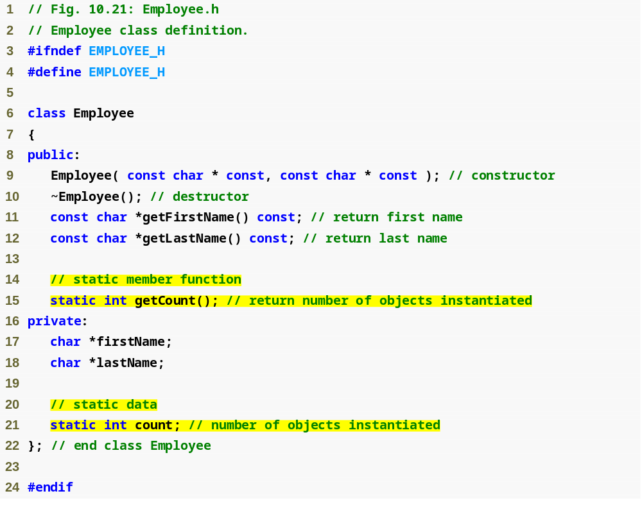
Outline
fig10_21.cpp
(1 of 1)
Function prototype for static member function
static data member keeps track of number of Employee objects that currently exist

Slide 93
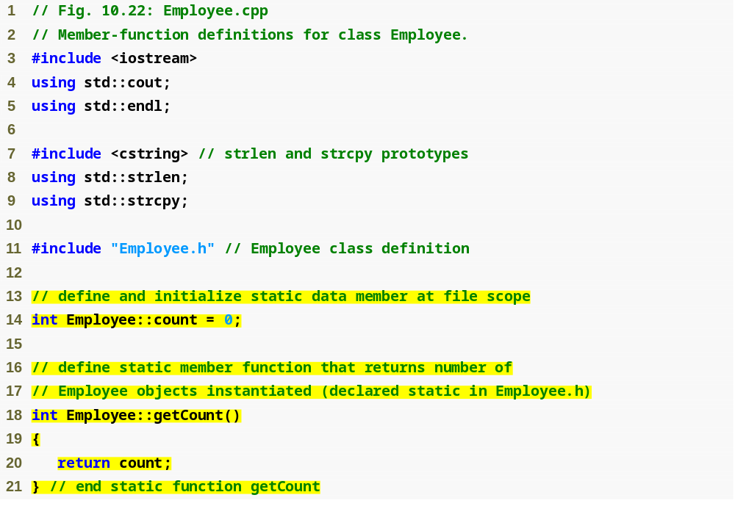
Outline
Employee.cpp
(1 of 3)
static data member is defined and initialized at file scope in the .cpp file
static member function can access only static data, because the function might be called when no objects exist

Slide 94
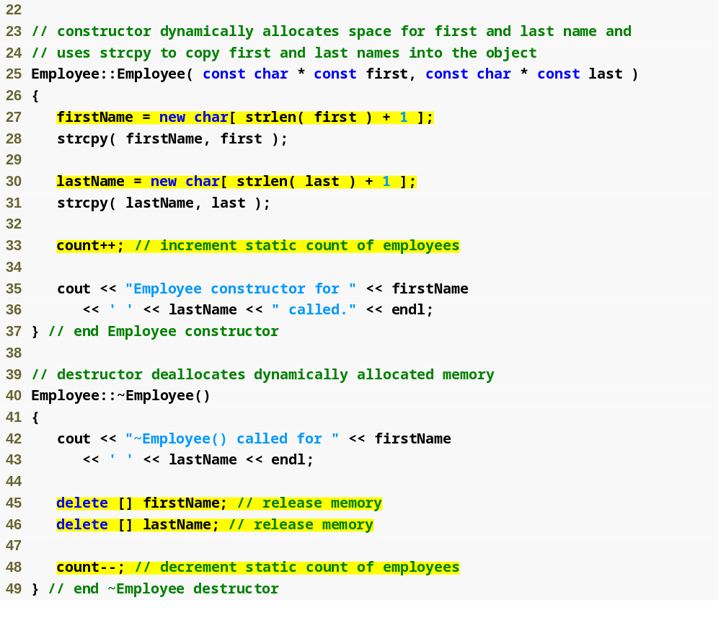
Outline
Employee.cpp
(2 of 3)
Dynamically allocating char arrays
Non-static member function (i.e., constructor) can modify the class’s static data members
Deallocating memory reserved for arrays

Slide 95
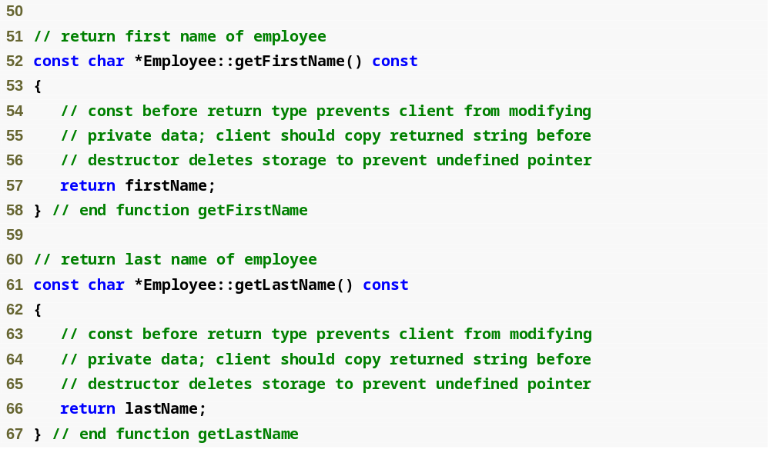
Outline
Employee.cpp
(3 of 3)

Slide 96
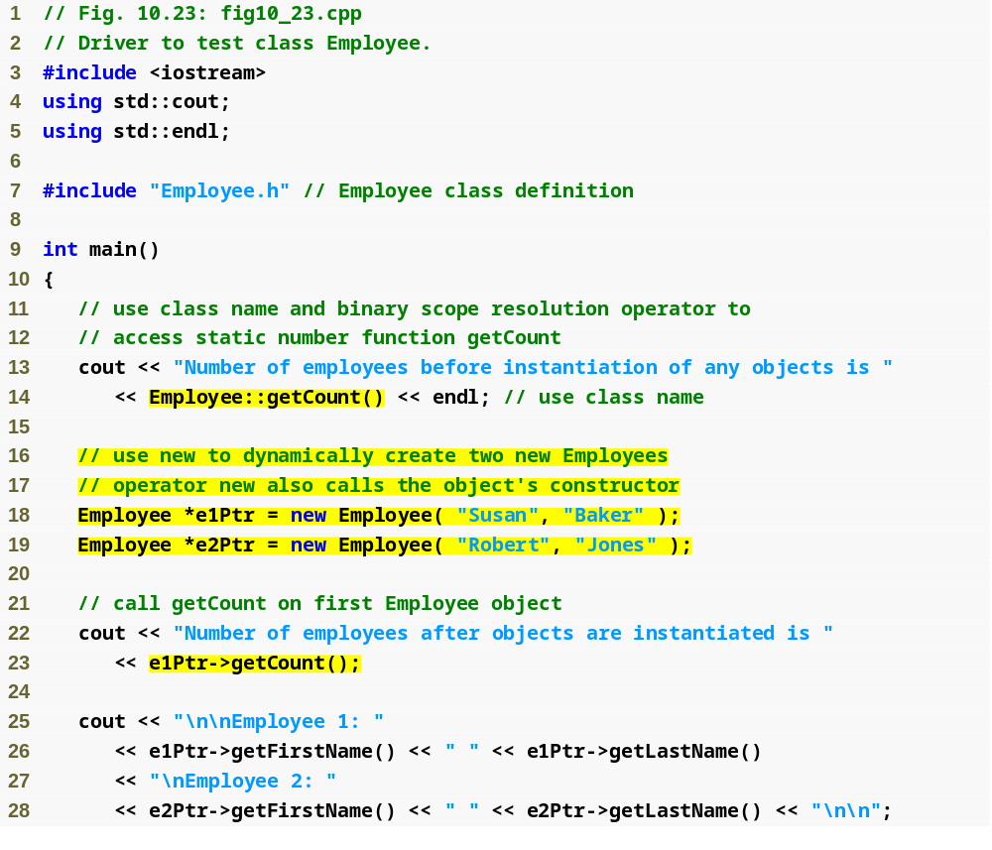
Outline
fig10_23.cpp
(1 of 2)
Calling static member function using class name and binary scope resolution operator
Dynamically creating Employees with new
Calling a static member function through a pointer to an object of the class

Slide 97
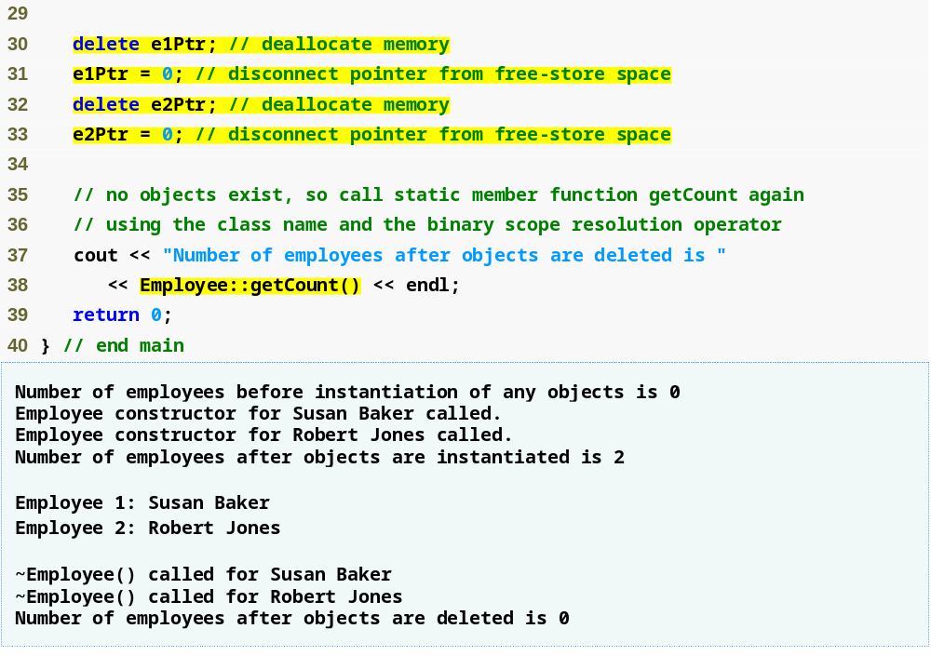
Outline
Releasing memory to which a pointer points
fig10_23.cpp
(2 of 2)
Disconnecting a pointer from any space in memory

Slide 98
10.7 static Class Members (Cont.)
Declare a member function static
  If it does not access non-static data members or non-static member functions of the class
  A static member function does not have a this pointer
  static data members and static member functions exist independently of any objects of a class
  When a static member function is called, there might not be any objects of its class in memory

Slide 99
Software Engineering Observation 10.12
Some organizations specify in their software engineering standards that all calls to static member functions be made using the class name and not an object handle.

Slide 100
Common Programming Error 10.11
Using the this pointer in a static member function is a compilation error.

Slide 101
Common Programming Error 10.12
Declaring a static member function const is a compilation error. The const qualifier indicates that a function cannot modify the contents of the object in which it operates, but static member functions exist and operate independently of any objects of the class.

Slide 102
Error-Prevention Tip 10.2
After deleting dynamically allocated memory, set the pointer that referred to that memory to 0. This disconnects the pointer from the previously allocated space on the free store. This space in memory could still contain information, despite having been deleted. By setting the pointer to 0, the program loses any access to that free-store space, which, in fact, could have already been reallocated for a different purpose. If you didn't set the pointer to 0, your code could inadvertently access this new information, causing extremely subtle, nonrepeatable logic errors.

Slide 103
10.8 Data Abstraction and Information Hiding
Information Hiding
  A class normally hides implementation details from clients
Data abstraction
  Client cares about what functionality a class offers, not about how that functionality is implemented
    For example, a client of a stack class need not be concerned with the stack’s implementation (e.g., a linked list)
  Programmers should not write code that depends on a class’s implementation details

Slide 104
10.8 Data Abstraction and Information Hiding (Cont.)
Importance of data
  Elevated in C++ and object-oriented community
    Primary activities of object-oriented programming in C++
      Creation of types (i.e., classes)
      Expression of the interactions among objects of those types
  Abstract data types (ADTs)
    Improve the program development process

Slide 105
10.8 Data Abstraction and Information Hiding (Cont.)
Abstract data types (ADTs)
  Essentially ways of representing real-world notions to some satisfactory level of precision within a computer system
  Types like int, double, char and others are all ADTs
    e.g., int is an abstract representation of an integer
  Capture two notions:
    Data representation
    Operations that can be performed on the data
  C++ classes implement ADTs and their services

Slide 106
10.8.1 Example: Array Abstract Data Type
Many array operations not built into C++
  e.g., subscript range checking
Programmers can develop an array ADT as a class that is preferable to “raw” arrays
  Can provide many helpful new capabilities
C++ Standard Library class template vector

Slide 107
Software Engineering Observation 10.12
You can create new types through the class mechanism. These new types can be designed to be used as conveniently as the built-in types. Thus, C++ is an extensible language. Although the language is easy to extend with these new types, the base language itself cannot be changed.

Slide 108
10.8.2 Example: String Abstract Data Type
No string data type among C++’s built-in data types
  C++ is an intentionally sparse language
    Provides programmers with only the raw capabilities needed to build a broad range of systems
    Designed to minimize performance burdens
    Designed to include mechanisms for creating and implementing string abstract data types through classes
  C++ Standard Library class string

Slide 109
10.8.3 Example: Queue Abstract Data Type
Queue ADT
  Items returned in first-in, first-out (FIFO) order
    First item inserted in the queue is the first item removed from the queue
  Hides an internal data representation that somehow keeps track of the items currently waiting in line
  Good example of an abstract data type
    Clients invoke enqueue operation to put things in the queue one at a time
    Clients invoke dequeue operation to get those things back one at a time on demand
  C++ Standard Library queue class

Slide 110
10.9 Container Classes and Iterators
Container classes (also called collection classes)
  Classes designed to hold collections of objects
  Commonly provide services such as insertion, deletion, searching, sorting, and testing an item to determine whether it is a member of the collection
  Examples
    Arrays
    Stacks
    Queues
    Trees
    Linked lists

Slide 111
10.9 Container Classes and Iterators (Cont.)
Iterator objects—or more simply iterators
  Commonly associated with container classes
  An object that “walks through” a collection, returning the next item (or performing some action on the next item)
  A container class can have several iterators operating on it at once
  Each iterator maintains its own “position” information

Slide 112
10.10 Proxy Classes
Header files contain some portion of a class’s implementation and hints about others
  For example, a class’s private members are listed in the class definition in a header file
  Potentially exposes proprietary information to clients of the class

Slide 113
10.10 Proxy Classes (Cont.)
Proxy class
  Hides even the private data of a class from clients
  Knows only the public interface of your class
  Enables the clients to use your class’s services without giving the client access to your class’s implementation details

Slide 114
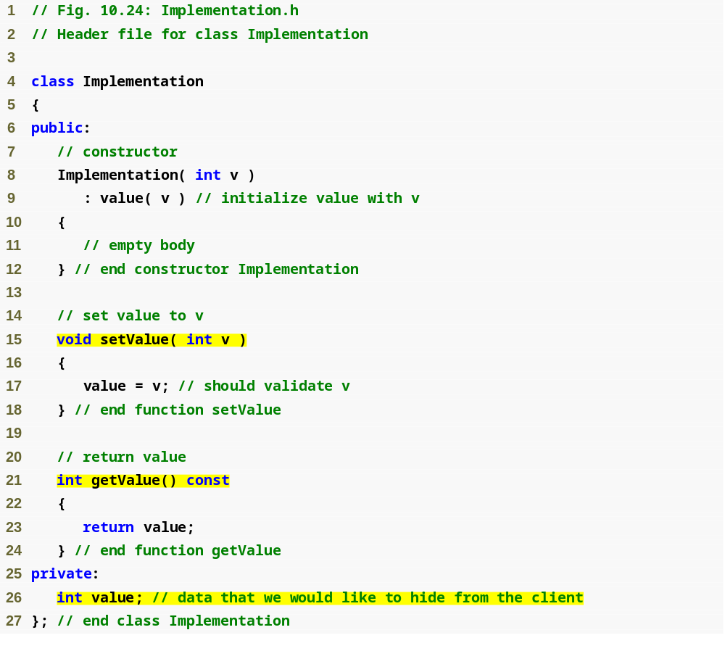
Outline
Class definition for the class that contains the proprietary implementation we would like to hide
Implementation.h
(1 of 1)
The data we would like to hide from the client

Slide 115
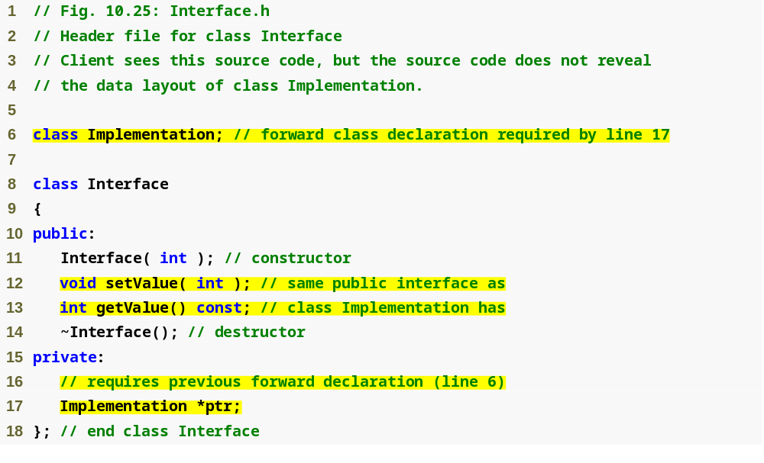
Outline
Interface.h
(1 of 1)
Declares Implementation as a data type without including the class’s complete header file
public interface between client and hidden class
Using a pointer allows us to hide implementation details of class Implementation

Slide 116
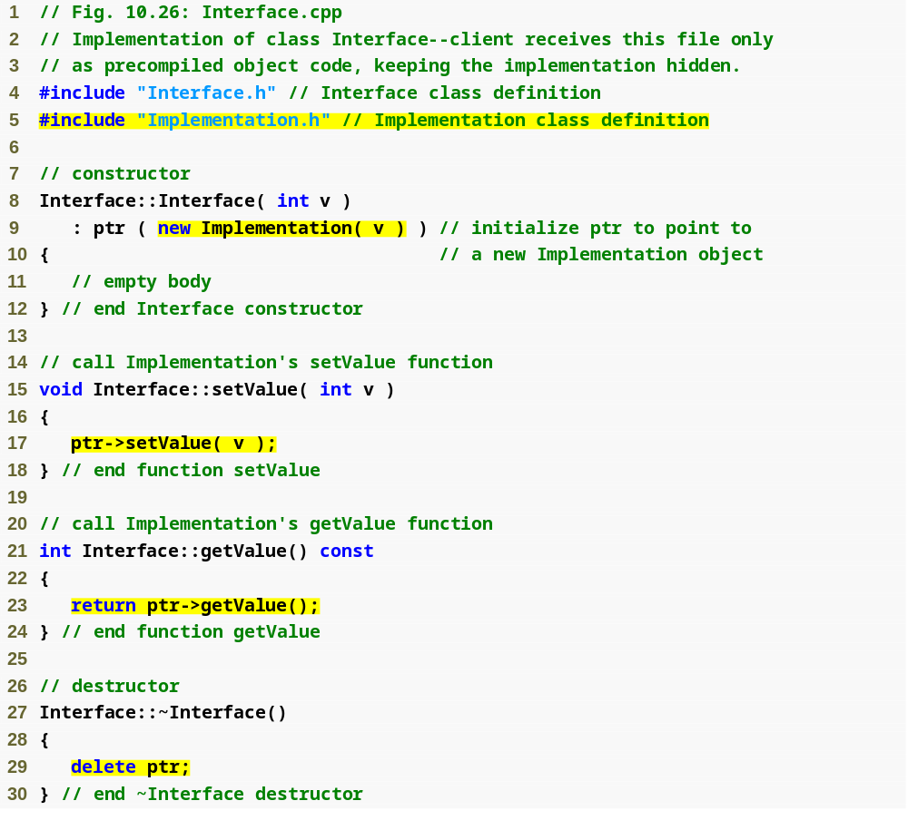
Outline
Interface.cpp
(1 of 1)
Only location where Implementation.h is included with #include
Setting the value of the hidden data via a pointer
Getting the value of the hidden data via a pointer

Slide 117
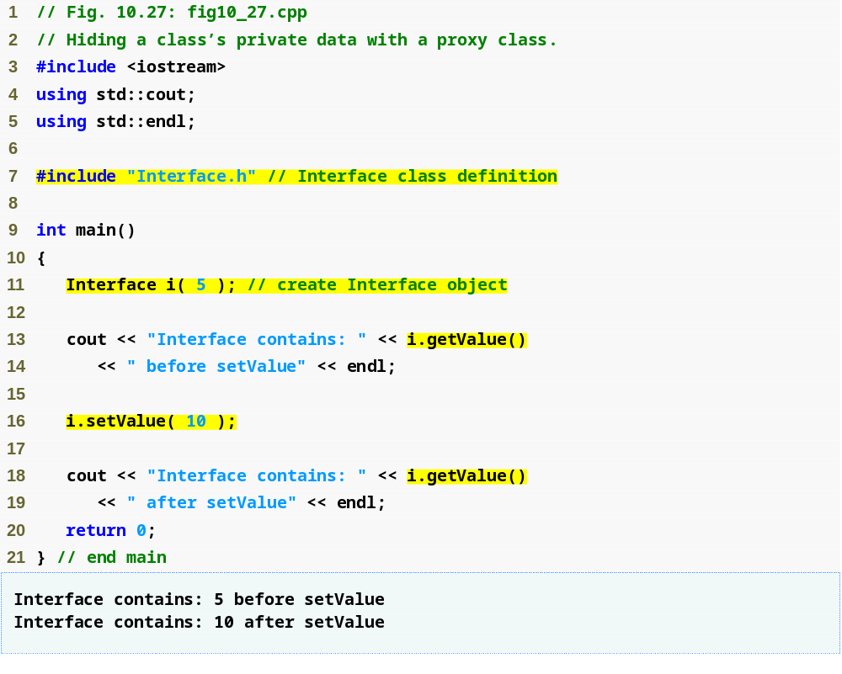
Outline
fig10_27.cpp
(1 of 1)
Only the header file for Interface is included in the client code—no mention of the existence of a separate class called Implementation

Slide 118
Software Engineering Observation 10.14
A proxy class insulates client code from implementation changes.

